Slide 1
LEARNING OUTCOME 2
Business and the Business Environment

Slide 2

LEARNING OUTCOME 2
Demonstrate the interrelationship of the various functions within an organisation and how they link to organisational structure

Slide 3

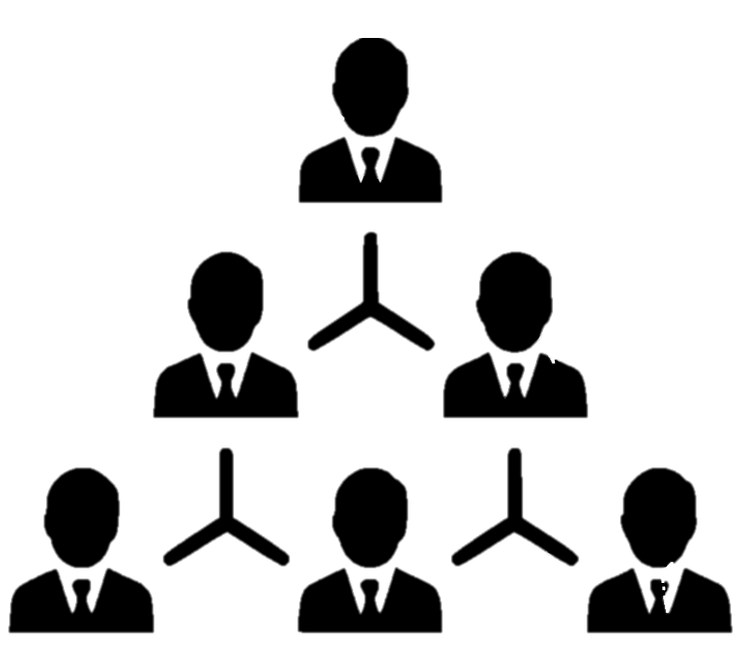
KEY LEARNING
1.The various functions within an organisation
2.Organisational structure

Slide 4
The various functions within an organisation:
An organization typically consists of several departments or functional areas, each responsible for performing specific tasks to achieve the organization's goals

Slide 5
Here are some common functions within an organization
Information technology:
The information technology function is responsible for managing the organization's technology infrastructure, including hardware, software, and networks.
Operations:
The operations function is responsible for managing the day-to-day activities of the organization. This includes production, manufacturing, service delivery, and logistics.
Human resources:
The human resources function is responsible for managing the organization's workforce.
Marketing:
The marketing function is responsible for promoting the organization's products or services to its target market.

Slide 6
The role of marketing
The role of marketing is to create, communicate, deliver and exchange offerings that have value for customers, clients, partners and society at large.
The primary goal of marketing is to satisfy customers' needs and wants profitably. In an organizational context, marketing plays a crucial role in achieving the organization's objectives by driving revenue growth, building brand awareness and loyalty, and creating a competitive advantage.

Slide 7
Here are some of the specific roles of marketing within an organizational context
Conducting market research:
Marketing plays a crucial role in identifying customers' needs and wants, understanding their preferences and behaviours, and gathering insights about the market trends and competition.
Developing marketing strategies:
Based on the market research insights, marketing develops strategies that target specific customer segments, position the organization's offerings, and create differentiation from competitors.
Creating brand awareness and loyalty:
Marketing is responsible for creating and managing the organization's brand identity, which represents its values, promises, and personality.

Slide 8
Role of finance
Finance plays a critical role in an organizational context by managing the organization's financial resources effectively.
The primary goal of finance is to ensure the organization's financial stability, profitability, and growth
Financial planning and analysis: Finance is responsible for developing and implementing financial plans and budgets that align with the organization's strategic goals.
Financial reporting and analysis: Finance is responsible for maintaining accurate financial records, preparing financial statements, and providing financial analysis and insights to support decision-making
Cash flow management: Finance is responsible for managing the organization's cash flow, ensuring that there is sufficient cash to meet operational and investment needs.

Slide 9
Role of HUMAN RESOURCE MANAGEMENT
Human resource management (HRM) plays a crucial role in an organizational context by managing the organization's human capital effectively.
The primary goal of HRM is to create a high-performing workforce that can achieve the organization's objectives and support its long-term success

Slide 10
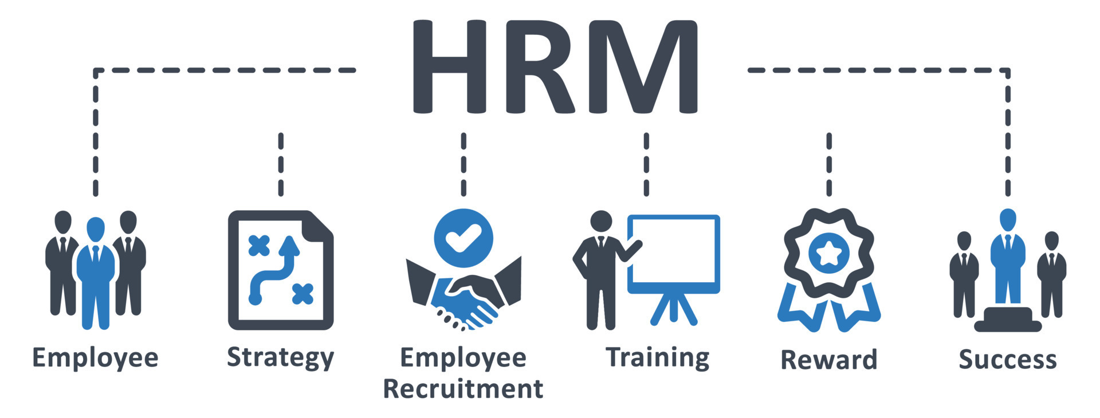
Here are some specific roles of HRM within an organizational
Recruitment and selection:
HRM is responsible for identifying and attracting the best talent to the organization
2.Training and development:
HRM is responsible for developing and implementing training and development programs that enhance employees' skills, knowledge, and abilities.
3.Performance management:
HRM is responsible for designing and implementing performance management processes that align with the organization's goals and objectives
4.Compensation and benefits:
HRM is responsible for developing and administering compensation and benefits programs that attract, retain, and motivate employees

Slide 11
Operations within an organisational context and the interrelationships
Operations refer to the core business activities that transform inputs into outputs, products or services.
Operations management plays a vital role in an organizational context by managing the organization's resources effectively and efficiently to produce high-quality products or services.

Slide 12
Here are some specific roles of operations within an organizational context:
Production planning and control:
Operations management is responsible for developing and implementing production plans and schedules that ensure timely and efficient production. Effective production planning and control help to optimize resource utilization, minimize waste and delay, and improve product quality.
3.Quality management: Operations management is responsible for ensuring that products or services meet customer requirements and specifications. Effective quality management helps to improve product reliability, reduce defect rates, and enhance customer satisfaction.
.
2.Inventory management:
Operations management is responsible for managing inventory levels, ensuring that there is sufficient inventory to meet customer demand while minimizing inventory holding costs.

Slide 13
Organisational structure
Organizational structure refers to the hierarchical arrangement of lines of authority, communications, rights and duties within an organization.
It defines how roles, power, and responsibilities are assigned and how information flows between different levels of management

Slide 14
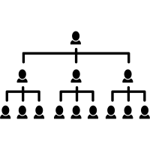
Bureaucratic structure
Bureaucratic structure is a hierarchical form of organization in which roles, responsibilities, and decision-making power are clearly defined and delegated to specific positions within the organization.
Bureaucratic structures are often characterized by a set of formal rules, regulations, and procedures that govern the behaviour and actions of employees within the organization.

Slide 15

Bureaucratic structures size scope
Bureaucratic size refers to the extent to which an organization has a large number of employees and hierarchical levels of management.
Bureaucratic scope, on the other hand, refers to the range and complexity of functions and activities that an organization undertakes

Slide 16

Example
Bureaucratic structure can be seen in government organizations, such as the United States Department of Defence.
The Department of Defence has a hierarchical structure with clearly defined roles and responsibilities at each level. The Secretary of Defence is at the top of the hierarchy, followed by the Deputy Secretary of Defence, Under Secretaries of Defence, Assistant Secretaries of Defence, and various other positions

Slide 17
Advantages / Disadvantages of Bureaucratic structure
Advantages:
Clear Roles and Responsibilities:
Bureaucratic structures provide clear roles and responsibilities for employees, reducing ambiguity and confusion.
2.Consistent Processes:
Bureaucratic structures prioritize standardization and consistency, which can lead to more efficient processes and high-quality outputs
Disadvantages:
Slow Decision-Making:
Bureaucratic structures can lead to slow decision-making as decision-making authority is centralized at higher levels of management.
2.Rigid Hierarchy:
Bureaucratic structures are often characterized by a rigid hierarchy, which can stifle creativity and innovation

Slide 18
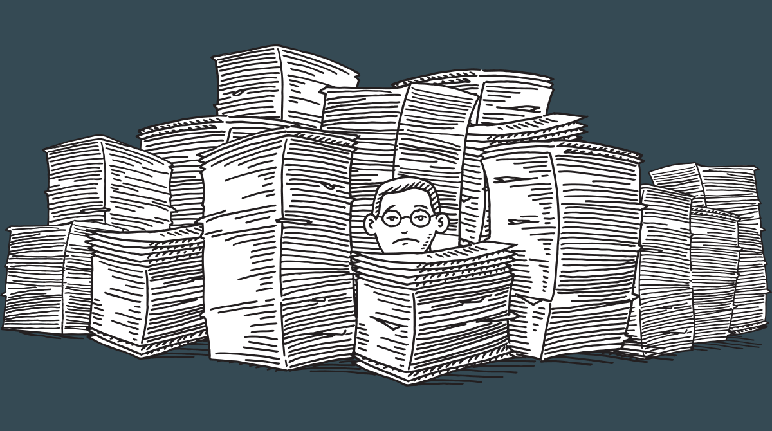
Post-bureaucratic refers to a type of organizational structure that differs from traditional bureaucratic structures. Post-bureaucratic structures are characterized by a focus on flexibility, decentralization, and employee empowerment. These structures aim to move away from the rigid and hierarchical nature of bureaucratic organizations and allow for more creativity, innovation, and adaptability
Post-bureaucratic

Slide 19
Here are some examples of post-bureaucratic organizations
Netflix:
Netflix is a popular streaming service that operates with a post-bureaucratic structure. The company is known for its decentralized decision-making and a culture that encourages creativity, experimentation, and innovation.
2.Zappos:
Zappos, an online shoe retailer, is another example of a post-bureaucratic organization. The company is known for its flat hierarchy, decentralized decision-making, and a focus on employee empowerment.
3.W.L. Gore & Associates:
W.L. Gore & Associates is a materials science company that operates with a post-bureaucratic structure. The company is known for its team-based approach to decision-making, flat hierarchy, and focus on employee empowerment.
4.Valve Corporation:
Valve Corporation is a video game developer that operates with a post-bureaucratic structure. The company is known for its flat hierarchy, decentralized decision-making, and a culture that values creativity and innovation.

Slide 20
Advantages / Disadvantages of post-bureaucratic
Advantages:
Flexibility:
Post-bureaucratic structures are designed to be flexible and adaptable to change. This allows organizations to respond quickly to changes in the business environment.
2.Innovation:
Post-bureaucratic structures prioritize creativity and innovation, encouraging employees to develop new ideas and solutions to problems.
Disadvantages:
Lack of Structure:
Post-bureaucratic structures can lack the structure and hierarchy of bureaucratic organizations, which can lead to confusion and ambiguity.
2.Lack of Accountability:
Post-bureaucratic structures can create a culture of shared responsibility, which can make it difficult to hold individuals accountable for their actions

Slide 21
Strategic Business Units
Strategic Business Units (SBUs) are semi-autonomous business entities within a larger organization that operate independently and have their own mission, objectives, and strategies.
SBUs are typically created to address specific market segments, products, or geographic regions and are managed separately from the rest of the organization

Slide 22
Here are some examples of Strategic Business Units
Coca-Cola: Coca-Cola operates multiple SBUs, such as the Coca-Cola North America SBU, which focuses on the North American market, and the Coca-Cola European Partners SBU, which operates in Europe.
Procter & Gamble: Procter & Gamble operates SBUs for its various product categories, such as the Fabric and Home Care SBU, which includes brands like Tide and Swiffer, and the Baby, Feminine and Family Care SBU, which includes brands like Pampers and Always.
GE: General Electric operates multiple SBUs, such as the Aviation SBU, which focuses on aircraft engines and related products, and the Healthcare SBU, which focuses on medical devices and equipment.
Sony: Sony operates multiple SBUs, such as the Electronics Products and Solutions SBU, which includes products like televisions and cameras, and the Music SBU, which includes the company's music and entertainment businesses.

Slide 23
Advantages / Disadvantages Strategic Business Units
Advantages :
Improved Focus:
SBUs enable an organization to focus on specific products, markets, or geographic regions, allowing for a more targeted and effective strategy.
2.Better Resource Allocation:
SBUs are typically managed separately from the rest of the organization, which allows for better allocation of resources based on the specific needs of each unit
Disadvantages:
Duplication of Effort:
SBUs can lead to duplication of effort and resources, as each unit may have its own separate functions and processes.
2.Coordination Challenges:
SBUs may lack coordination and communication with the rest of the organization, leading to fragmentation and inefficiency.

Slide 24

Matrix Structure
Matrix different organizational structures that companies can use to manage their operations.
Matrix Structure:
In a matrix structure, employees are organized by both function and project or product teams.
This means that each employee has two reporting lines - one to their functional manager and one to their project or product manager.
The benefits of a matrix structure include increased flexibility and adaptability to changing business needs, as well as the ability to leverage specialized expertise.
However, this structure can also create ambiguity and confusion around job roles and responsibilities, as well as potential conflicts between functional and project managers.

Slide 25
Here are some examples of companies that use matrix and functional structures
Matrix Structure Examples:
Procter & Gamble:
P&G uses a global matrix structure, with product teams and geographic regions working together in a matrix structure.
NASA:
NASA's project-based work is organized in a matrix structure, with employees working on specific projects while also reporting to functional managers.
Construction Company:
A construction company might use a matrix structure to organize employees into departments based on their areas of expertise, such as engineering, architecture, project management, and procurement. Employees in each department would also work on specific projects, with project managers overseeing their work on each project.
Advertising Agency:
An advertising agency might use a matrix structure to group employees into departments based on their areas of expertise, such as creative, account management, media planning, and finance.

Slide 26
Advantages / Disadvantages Matrix Structure
Advantages:
Enhanced Collaboration: The matrix structure promotes cross-functional collaboration and communication, leading to a more integrated and efficient approach to projects and goals.
Flexibility: The matrix structure allows for flexibility and adaptability to changing business environments, as employees can move between projects and functions as needed.
Improved Decision-Making: The matrix structure allows for multiple perspectives and input in decision-making, leading to more informed and effective decisions
Disadvantages:
Complex and Confusing: The matrix structure can be complex and confusing to navigate, with employees having to manage multiple reporting lines and priorities.
Conflict and Tension: The matrix structure can lead to conflict and tension, as employees may have differing priorities and demands from their two reporting lines.

Slide 27
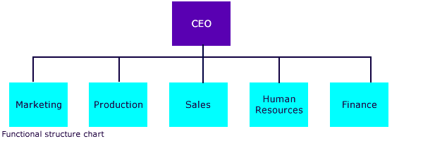
Functional Structure
Functional levels are organizational structures that companies can use to manage their operations.
Functional Structure:
In a functional structure, employees are grouped together based on their specific functions, such as finance, marketing, or operations.
This structure is typically hierarchical, with each function reporting to a manager or director.
The benefits of a functional structure include clear lines of communication, clear job roles and responsibilities, and the ability to focus on specific areas of expertise.
However, the structure can also create silos and hinder communication and collaboration between different departments

Slide 28
Functional Structure Examples
1.Functional Structure Examples:
Ford Motor Company:
Ford's organizational structure is functional, with employees grouped by functions such as marketing, finance, and engineering.
Walmart:
Walmart uses a functional structure, with employees grouped by departments such as merchandising, operations, and human resources.
Manufacturing Company:
A manufacturing company might use a functional structure to organize employees into departments based on their areas of expertise, such as production, quality control, engineering, and logistics.
Law Firm:
A law firm might use a functional structure to group lawyers and support staff into departments based on their areas of expertise, such as litigation, corporate law, tax law, and administrative support.
Hospital:
A hospital might use a functional structure to organize employees into departments based on their areas of expertise, such as nursing, surgery, radiology, and administration.

Slide 29
Advantages / Disadvantages Functional Structure
Advantages:
Clear Roles and Responsibilities: The functional structure provides clear roles and responsibilities for each employee, leading to greater efficiency and accountability.
Expertise and Specialization: The functional structure allows employees to develop expertise and specialization in their specific area of the organization, leading to higher-quality work and outcomes.
Clear Career Path: The functional structure provides a clear career path for employees within their specific function, leading to greater job satisfaction and retention.
Disadvantages:
Silos and Communication Barriers: The functional structure can lead to silos and communication barriers between functions, hindering collaboration and innovation.
2.Limited Flexibility: The functional structure can limit flexibility and adaptability to changing business environments, as employees may be less likely to move between functions.

Slide 30
Complexities in Organisation structures
Communication:
As organizations grow and become more complex, communication can become more difficult. Communication breakdowns can lead to misunderstandings, mistakes, and inefficiencies.
2.Coordination:
Coordinating activities across different departments and teams can also be challenging in complex organizations. This can lead to delays, redundancies, and conflicts.
3.Decision-making:
Decision-making can become more complex in large organizations with multiple layers of management. Decisions may take longer to make and may be influenced by competing interests and priorities.

Slide 31
Summary
The functions within an organization, such as finance, marketing, operations, human resources, and others, are interconnected and interdependent.
Each function contributes to the overall success of the organization and works together to achieve its goals.
The organizational structure determines how these functions are arranged and how they interact with each other.
For example, the finance function manages the financial resources of the organization, including budgeting, accounting, and financial reporting.
The marketing function is responsible for promoting the organization's products or services, creating brand awareness, and developing marketing strategies.
Organizational structures can become complex and create various challenges. Some of the key complexities include communication breakdowns, coordination challenges, decision-making difficulties, inflexibility, silos, cultural barriers, and employee morale issues.

Slide 32
Thank You

